Slide 1
Philippians 4v2-9 Peace on Earth
Humility (2v1-11)
Christ alone (3v1-11)
Pressing on
(3v12-4v1
Peace (4v2-9)

Slide 2
Philippians 4v2-9
I plead with Euodia and I plead with Syntyche to be of the same mind in the Lord. ³ Yes, and I ask you, true companion, help these women since they have contended at my side in the cause of the gospel, along with Clement and the rest of my co-workers, whose names are in the book of life.
⁴ Rejoice in the Lord always. I will say it again: rejoice! ⁵ Let your gentleness be evident to all. The Lord is near. ⁶ Do not be anxious about anything, but in every situation, by prayer and petition, with thanksgiving, present your requests to God. ⁷ And the peace of God, which transcends all understanding, will guard your hearts and your minds in Christ Jesus.

Slide 3
Philippians 4v2-9
⁸ Finally, brothers and sisters, whatever is true, whatever is noble, whatever is right, whatever is pure, whatever is lovely, whatever is admirable – if anything is excellent or praiseworthy – think about such things. ⁹ Whatever you have learned or received or heard from me, or seen in me – put it into practice. And the God of peace will be with you.

Slide 4
Phil 4v2-3 – Paul’s appeal for peace
“I plead with Euodia”
“I plead with Syntyche”
“I ask you, true companion help these women who contended at my side in the cause of the gospel”

Slide 5
Philippians 4v4 – Recipe for peace
Living Rom 8v28
When are we to rejoice?
How are we to rejoice?
Say it again! Rejoice

Slide 6
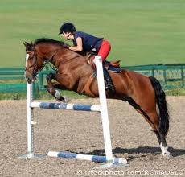
4V5 showing Gentleness/meekness – recipe for peace
“A gentle answer
turns away wrath,
but a harsh word
stirs up anger.”
Prov 15v1
“Because the Lord is near”
Strength under control

Slide 7
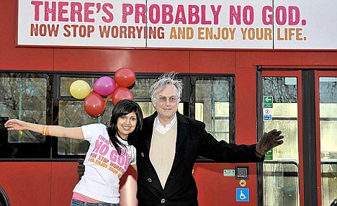
Recipe for peace - Do not be anxious v6

Slide 8
Recipe for peace - V6 do not be anxious
Pulled
Apart

Slide 9
Recipe for strife - James 4
“What causes fights among you? You want something and do not get it. You kill and you covet, but you cannot have what you want. You do not have because you do not ask God. When you ask you do not receive because you ask with wrong motives, that you may spend what you get on your pleasures”
James 4v1-3
Pulled
Apart

Slide 10
Phil4 the prayer and peace passage
Do not be anxious about anything, but in prayer and petition, with thanksgiving, present your requests to God. And the peace of God, which transcends all understanding, will guard your hearts and minds in Christ Jesus. Ph 4v6-7
Pulled
Apart
What causes fights among you? James 4v1-3

Slide 11
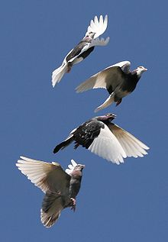
Recipe for peace - Prayer and petition with Thanksgiving – 4v6
“Prayer without thanksgiving is like a bird without wings: such prayer cannot rise to heaven, can find no acceptance with God”
Hendricksen

Slide 12
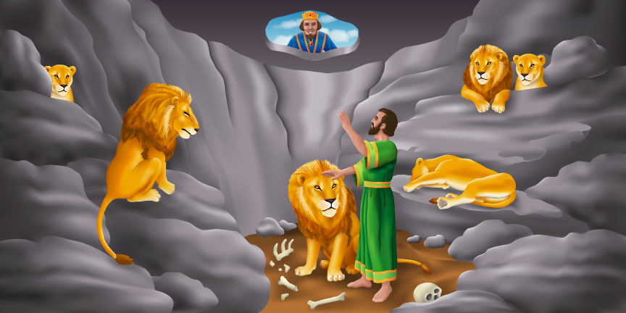
Peace of God which transcends all understanding
Daniel 6v18 ”Then the king returned to his palace and spent the night without eating and without any entertainment being brought to him. And he could not sleep.”

Slide 13
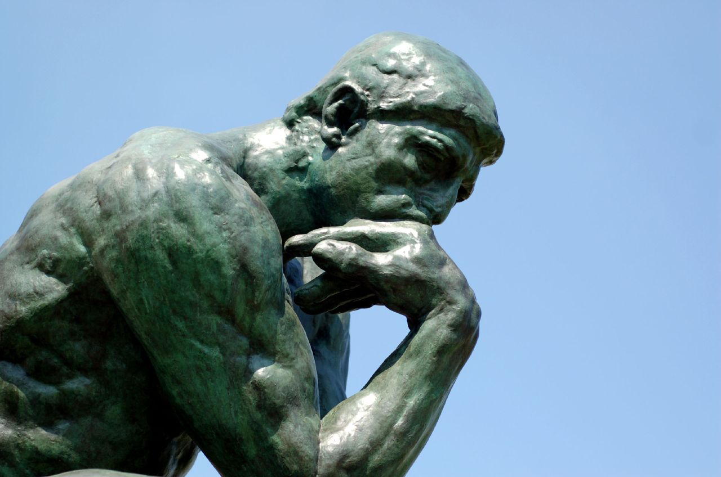
Think on these things 4v8
True, noble, right, pure, lovely admirable, excellent, praiseworthy

Slide 14
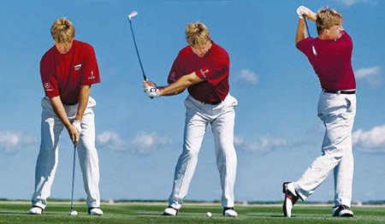
Put into Practice 4v9 Promise of peace
V7 “And the peace of God will guard your hearts”
V9 “And the God of peace will be with you”

